Slide 2
Transmission Terminology (1)
Data transmission occurs between transmitter and receiver over some transmission medium.
Transmission media may be classified as guided or unguided.
In both cases, communication is in the form of electromagnetic waves.
Guided media
waves are guided along a physical path
examples of guided media are twisted pair, coaxial cable, and optical fiber.
Unguided media, also called wireless
provide a means for transmitting electromagnetic waves but do not guide them
examples are propagation through air, vacuum, and seawater.

Slide 3
Transmission Terminology (2)
direct link -used to refer to the transmission path between two devices in which signals propagate directly from transmitter to receiver with no intermediate devices, other than amplifiers or repeaters used to increase signal strength.
Note that this term can apply to both guided and unguided media.

Slide 4
Transmission Terminology (3)
A guided transmission medium is point to point
if it provides a direct link between two devices and those are the only two devices sharing the medium.
multipoint guided configuration
more than two devices share the same medium.

Slide 5
Transmission Terminology (4)
Frequency, Spectrum, and Bandwidth
electromagnetic signals used as a means to
transmit data
The signal is a function of time
can also be expressed as a function of frequency;
i.e the signal consists of components of different
frequencies.

Slide 6
Transmission Terminology (5)
Time Domain Concepts
Viewed as a function of time, an electromagnetic signal
can be either analog or digital.
An analog signal is one in which the signal intensity varies in a smooth fashion over time. i.e no breaks or discontinuities in the signal. Ex, speech
A digital signal is one in which the signal intensity maintains a constant level for some period of time and then abruptly changes to another constant Level. Ex binary 0,1.

Slide 7
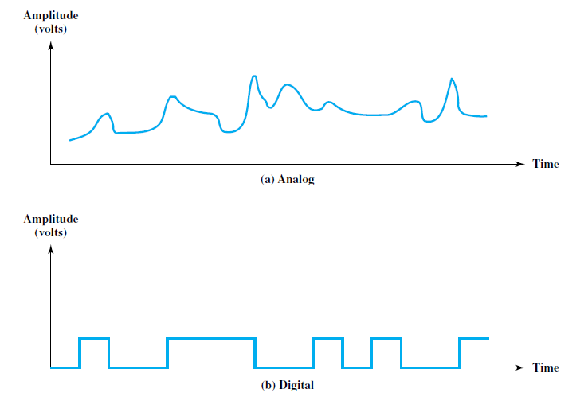
Transmission Terminology (6)
Time Domain Concepts

Slide 8
Transmission Terminology (7)
Frequency Domain Concepts
electromagnetic signal will be made up of many frequencies. (T=1/f)
Fundamental frequency
Period of total signal

Slide 9
Transmission Terminology (8)
Relationship between Data Rate and Bandwidth
Effective bandwidth is the band within which most of the signal energy is concentrated.
given waveform may contain frequencies over a very broad range, as a practical matter any transmission system will be able to accommodate only a limited band of frequencies.
This, in turn, limits the data rate that can be carried on the transmission medium.

Slide 10
ANALOG AND DIGITAL DATA TRANSMISSION (1)
data is entities that convey meaning, or information.
Signals are electric or electromagnetic representations of data.
Signaling is the physical propagation of the signal along a suitable medium.
Transmission is the communication of data by the propagation and processing of signals.

Slide 11
ANALOG AND DIGITAL DATA TRANSMISSION (2)

Slide 12
ANALOG AND DIGITAL DATA TRANSMISSION (3)

Slide 13
ANALOG AND DIGITAL DATA TRANSMISSION (4)

Slide 14
ANALOG AND DIGITAL DATA TRANSMISSION (5)

Slide 15
ANALOG AND DIGITAL DATA TRANSMISSION (6)

Slide 16
ANALOG AND DIGITAL DATA TRANSMISSION (7)
Both long-haul telecommunications facilities and intra-building services have moved to digital transmission and, where possible, digital signaling techniques. The most important reasons are as follows:

Slide 17
ANALOG AND DIGITAL DATA TRANSMISSION (8)
Digital technology: The advent of large-scale integration (LSI) and very-largescale integration (VLSI) technology has caused a continuing drop in the cost and size of digital circuitry. Analog equipment has not shown a similar drop.
• Data integrity: With the use of repeaters rather than amplifiers, the effects of noise and other signal impairments are not cumulative. Thus it is possible to transmit data longer distances and over lower quality lines by digital means while maintaining the integrity of the data.

Slide 18
ANALOG AND DIGITAL DATA TRANSMISSION (9)
Capacity utilization: It has become economical to build transmission links of very high bandwidth, including satellite channels and optical fiber. A high degree of multiplexing is needed to utilize such capacity effectively, and this is more easily and cheaply achieved with digital (time division) rather than analog (frequency division) techniques.
Security and privacy: Encryption techniques can be readily applied to digital data and to analog data that have been digitized.
Integration: By treating both analog and digital data digitally, all signals have the same form and can be treated similarly. Thus economies of scale and convenience can be achieved by integrating voice, video, and digital data.

